Slide 1

LEGAL, MORAL, & ETHICAL ISSUES IN COMPUTING
Navigating the Complex Landscape of
Technology and Society

Slide 2
Do Now
Is it acceptable for companies to collect personal data about users? Explain your answer

Slide 3




RESPONSE
It depends on...
HOW THEY COLLECT IT:
WHY THEY COLLECT IT:
CAN THEY BUY IT?
For relevant purposes, this should be stated at the point of consent
If you have accepted Terms and Conditions from original data collectors that state sharing with 3rd parties e.g for Marketing - Yes
With consent - Yes
Without your consent - No
CAN YOU ASK FOR YOUR DATA TO BE REMOVED?
Yes, you need to notify the company usually in writing

Slide 4









Area and Key Focus
ETHICAL
LEGAL
CULTURAL
ENVIRONMENTAL
PRIVACY
ETHICAL
LEGAL
CULTURAL
ENVIRONMENTAL
PRIVACY
What is "right" vs. "wrong" (e.g., AI bias, the Digital Divide).
The Law (Data Protection Act, Computer Misuse Act, Copyright).
How computing affects society (Social media, 24/7 self-monitoring).
Energy consumption, e-waste, and precious metals.
Surveillance, data mining, and "the right to be forgotten."

Slide 5
Ethical framework mindmap

Slide 6

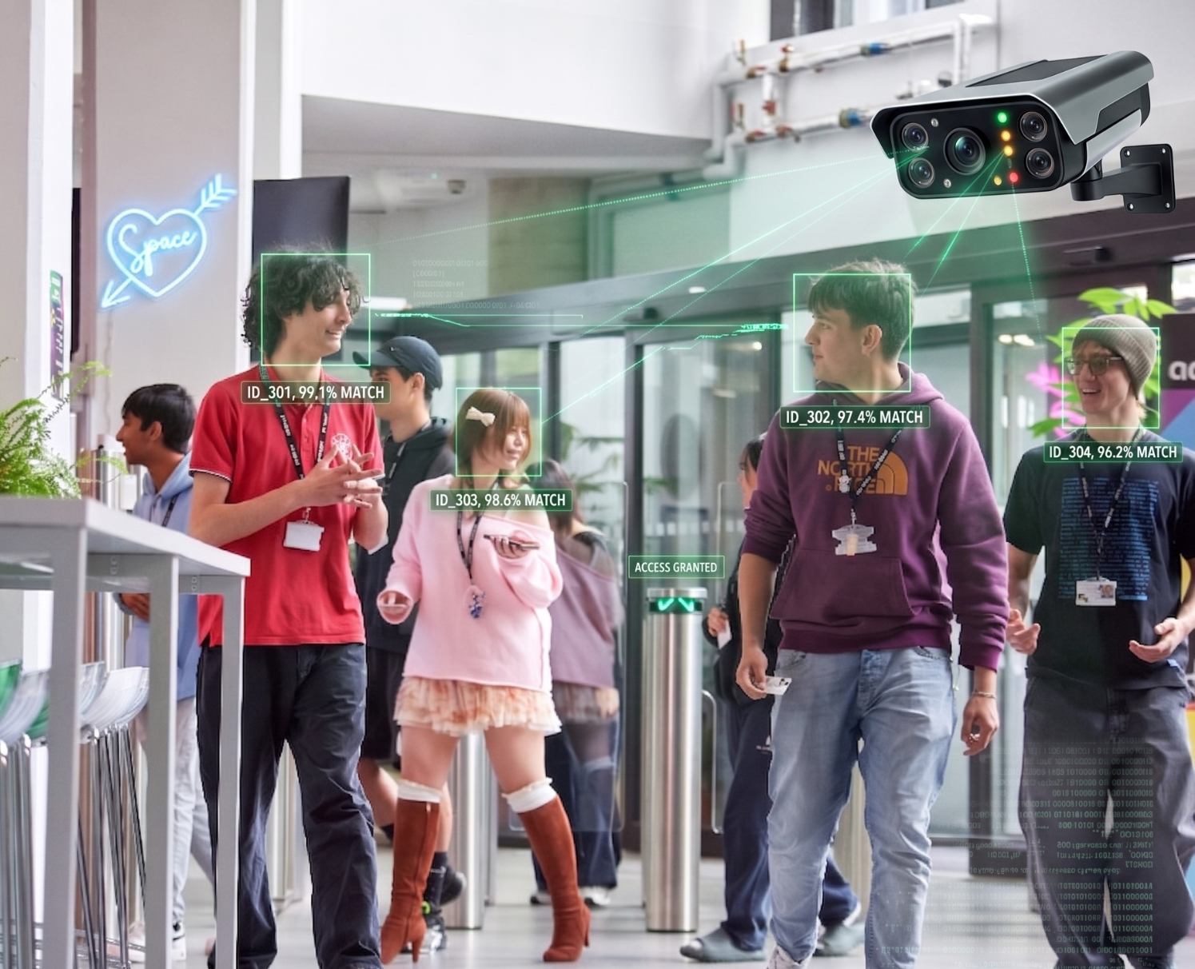
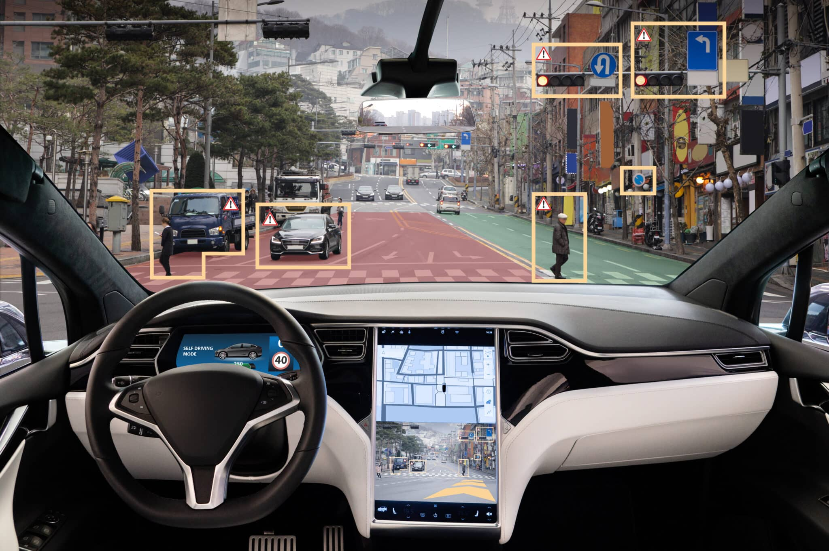
Glimpse into Ethical Scenarios
Thinking Framework: For each scenario, consider...
What is the ethical issue?
Who is affected?
One argument for
One argument against
1. Facial recognition in schools
2. Self-driving cars making decisions

Slide 7








Facial recognition in schools
Ethical Issue: Privacy due to surveillance
Stakeholders
Benefits
Drawbacks
•
Students
•
Increased security
•
Privacy violation
•
Parents/Guardians
•
Automated attendance
•
Potential for bias
•
Teachers & Staff
•
Normalisation of surveillance
•
Efficient access
•
School Administration

Slide 8
Self-driving cars making decisions
Ethical Issue: Cultural & Social
Stakeholders
Benefits
Drawbacks
•
Passengers
•
Potential for significantly reduce accidents
•
Potential for system failures or hacking
•
Pedestrians
•
•
Liability issues in case of accidents
•
Other drivers
Increased mobility for those unable to drive
•
Car manufacturers
•
Job displacement for professional drivers
•
Improved traffic flow and efficiency
•
Technology Providers

Slide 9
Mastering the 8-Marker
In the exam, 8-markers are marked on levels. To hit Level 3 (7-8 marks), you must show “breadth and depth” and a “logical structure.”
The “IDEAL” Structure
I - Identify: Name the issue (e.g., “One ethical issuse is privacy.”)
D - Describe: Explain what it is.
E - Explain: How does it affect people/the environment?
A - Analyse: Give two sides. “On the one hand… however…”
L - Link: Bring it back to the specific scenario in the question

Slide 10
Scenario: Autonomous Robots in Warehousing
“A company plans to replace its human warehouse workers with autonomous robots. Discuss the Ethical and Cultural issues of this decision.”
I-D-E-A-L Response Structure
I - Identify: One ethical issue is…
D - Describe: This means…
E - Explain: This affects people because…
A - Analyse: On one hand… however…
L - Link: Therefore, in this situation…

Slide 11
How many marks?
Success criteria
Clear ethical issue identified (job loss)
Developed explanation of impact on people
Balanced argument (benefits vs harms)
Includes cultural point (community values, identity)
Strong link back to the scenario
Uses keywords: efficiency, unemployment, community
One ethical issue is job loss.
Robots will replace workers.
This is bad because people could lose their jobs.

Slide 12
How many marks?
Success criteria
Clear ethical issue identified (job loss)
Developed explanation of impact on people
Balanced argument (benefits vs harms)
Includes cultural point (community values, identity)
Strong link back to the scenario
Uses keywords: efficiency, unemployment, community
One ethical issue is job loss.
Robots will replace workers.
This is bad because people could lose their jobs.
Why This is 2 Marks
✔ Identifies an issue
✔ Very basic explanation
❌ No development (no detail about impact)
❌ No analysis (only one side)
❌ No cultural issues
❌ No link back to the scenario

Slide 13
How many marks?
One ethical issue is job loss.
This is where workers are replaced by robots that can do the work automatically.
This affects people because they may lose their jobs and not have money.
On one hand, robots can make work faster and cheaper for the company. However, it is bad for workers because they may become unemployed.
Therefore, replacing workers with robots can cause problems for people.
Success criteria
Clear ethical issue identified (job loss)
Developed explanation of impact on people
Balanced argument (benefits vs harms)
Includes cultural point (community values, identity)
Strong link back to the scenario
Uses keywords: efficiency, unemployment, community

Slide 14
How many marks?
One ethical issue is job loss.
This is where workers are replaced by robots that can do the work automatically.
This affects people because they may lose their jobs and not have money.
On one hand, robots can make work faster and cheaper for the company. However, it is bad for workers because they may become unemployed.
Therefore, replacing workers with robots can cause problems for people.
Success criteria
Clear ethical issue identified (job loss)
Developed explanation of impact on people
Balanced argument (benefits vs harms)
Includes cultural point (community values, identity)
Strong link back to the scenario
Uses keywords: efficiency, unemployment, community
Why This is 4 Marks
✔ Identifies an issue
✔ Some explanation of impact
✔ Includes both sides (basic analysis)
❌ Some detail but not enough development
❌ Cultural issues not clearly explored
❌ Weak final link to scenario

Slide 15
I – Identify One ethical issue is job loss due to automation.

Slide 16
I – Identify One ethical issue is job loss due to automation.
D – Describe This is where human workers are replaced by robots that can carry out tasks automatically without needing breaks or wages.

Slide 17
I – Identify One ethical issue is job loss due to automation.
D – Describe This is where human workers are replaced by robots that can carry out tasks automatically without needing breaks or wages.
E – Explain This affects workers because they may lose their jobs and income, which could lead to financial difficulties and increased unemployment in society.

Slide 18
I – Identify One ethical issue is job loss due to automation.
D – Describe This is where human workers are replaced by robots that can carry out tasks automatically without needing breaks or wages.
E – Explain This affects workers because they may lose their jobs and income, which could lead to financial difficulties and increased unemployment in society.
A – Analyse On one hand, using autonomous robots can benefit the company as it reduces costs, increases efficiency, and allows tasks to be completed more quickly and accurately. However, it is unethical to prioritise profit over people, as workers may struggle to find new employment, especially if they do not have the skills needed for other jobs. Additionally, there may be cultural issues, as some communities place high value on stable employment and human roles, and replacing workers with machines could negatively impact social structures and community identity.

Slide 19
I – Identify One ethical issue is job loss due to automation.
D – Describe This is where human workers are replaced by robots that can carry out tasks automatically without needing breaks or wages.
E – Explain This affects workers because they may lose their jobs and income, which could lead to financial difficulties and increased unemployment in society.
A – Analyse On one hand, using autonomous robots can benefit the company as it reduces costs, increases efficiency, and allows tasks to be completed more quickly and accurately. However, it is unethical to prioritise profit over people, as workers may struggle to find new employment, especially if they do not have the skills needed for other jobs. Additionally, there may be cultural issues, as some communities place high value on stable employment and human roles, and replacing workers with machines could negatively impact social structures and community identity.
L – Link Therefore, in the case of replacing warehouse workers with autonomous robots, there is a clear ethical and cultural conflict between improving efficiency and protecting workers and communities.

Slide 20
I – Identify One ethical issue is job loss due to automation.
D – Describe This is where human workers are replaced by robots that can carry out tasks automatically without needing breaks or wages.
E – Explain This affects workers because they may lose their jobs and income, which could lead to financial difficulties and increased unemployment in society.
A – Analyse On one hand, using autonomous robots can benefit the company as it reduces costs, increases efficiency, and allows tasks to be completed more quickly and accurately. However, it is unethical to prioritise profit over people, as workers may struggle to find new employment, especially if they do not have the skills needed for other jobs. Additionally, there may be cultural issues, as some communities place high value on stable employment and human roles, and replacing workers with machines could negatively impact social structures and community identity.
L – Link Therefore, in the case of replacing warehouse workers with autonomous robots, there is a clear ethical and cultural conflict between improving efficiency and protecting workers and communities.
Why This Hits Top Marks
✔ Clear ethical issue identified (job loss)
✔ Developed explanation of impact on people
✔ Balanced argument (benefits vs harms)
✔ Includes cultural point (community values, identity)
✔ Strong link back to the scenario
✔ Uses keywords: efficiency, unemployment, community

Slide 21
“A social media company uses algorithms to decide what content users see on their feeds. Discuss the ethical and cultural issues of this decision.”
I-D-E-A-L Response Structure
I - Identify: One ethical issue is…
D - Describe: This means…
E - Explain: This affects people because…
A - Analyse: On one hand… however…
L - Link: Therefore, in this situation…

Slide 22
One ethical issue is bias in algorithms. I
✔

Slide 23
One ethical issue is bias in algorithms. I
This is where algorithms prioritise certain types of content based on user data, meaning not all information is shown equally. D
✔
✔
✔

Slide 24
One ethical issue is bias in algorithms. I
This is where algorithms prioritise certain types of content based on user data, meaning not all information is shown equally. D
This affects users because it can shape their opinions and limit their exposure to different viewpoints, potentially leading to misinformation E
✔
✔
✔
✔

Slide 25
One ethical issue is bias in algorithms. I
This is where algorithms prioritise certain types of content based on user data, meaning not all information is shown equally. D
This affects users because it can shape their opinions and limit their exposure to different viewpoints, potentially leading to misinformation E
On one hand, algorithms improve user experience by showing personalised content, making platforms more engaging and efficient to use. This can benefit both users and companies. However, it can also be unethical because it may manipulate what people see without their full awareness, reducing freedom of choice. Additionally, there are cultural issues, as different cultures value access to diverse information differently, and limiting viewpoints could reinforce stereotypes or bias. A
✔
✔
✔
✔
✔
✔
✔

Slide 26
One ethical issue is bias in algorithms. I
This is where algorithms prioritise certain types of content based on user data, meaning not all information is shown equally. D
This affects users because it can shape their opinions and limit their exposure to different viewpoints, potentially leading to misinformation E
On one hand, algorithms improve user experience by showing personalised content, making platforms more engaging and efficient to use. This can benefit both users and companies. However, it can also be unethical because it may manipulate what people see without their full awareness, reducing freedom of choice. Additionally, there are cultural issues, as different cultures value access to diverse information differently, and limiting viewpoints could reinforce stereotypes or bias. A
Therefore, in the case of social media algorithms, there is a clear ethical and cultural concern about balancing personalisation with fairness and access to a wide range of information. L
✔
✔
✔
✔
✔
✔
✔
✔

Slide 27
“A large technology company builds data centres that use huge amounts of electricity and water.
Discuss the ethical and environmental issues of this decision.”

Slide 28
One ethical and environmental issue is the high energy and water consumption of data centres.
This is where large buildings full of computer servers store and process data for services such as websites, cloud storage, and streaming, but they require constant electricity and cooling systems that often use large amounts of water.
This affects the environment because it increases carbon emissions if the electricity comes from non-renewable sources, contributing to climate change. It can also put pressure on local water supplies, especially in areas where water is already limited.
On one hand, data centres are essential because they support modern digital services such as online banking, communication, and cloud storage, which are used by millions of people every day and help businesses operate efficiently. However, they are environmentally damaging because they consume large amounts of energy and water, which can contribute to pollution and resource shortages. This raises ethical concerns about whether companies should prioritise profit and convenience over environmental sustainability. Additionally, companies may face pressure to reduce their environmental impact by investing in renewable energy or more efficient cooling systems, which shows there is a responsibility to balance technology use with environmental protection.
Therefore, in the case of large technology companies building data centres, there is a clear conflict between providing essential digital services and reducing environmental harm caused by high energy and water usage.

Slide 29
A school introduces a policy where all student messages on the school network are monitored by software to detect cyberbullying.
Discuss the ethical and cultural issues of this decision.

Slide 30




Any questions?

