Slide 1

Ada, the National College for Digital Skills GCSE Revision - Algorithms
Reflection on data types, functions, tracing tables and developing a solution
Ada Computer Science Team

Slide 2

Data types

Slide 3

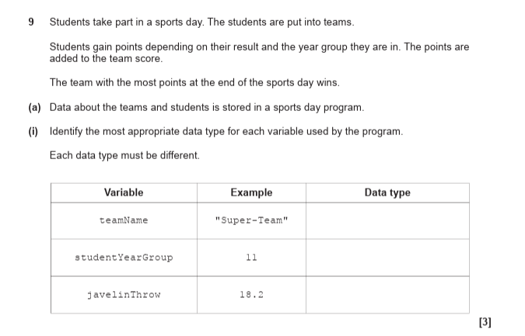
Jun 2024

Slide 4
Jun 2024
String
Integer
Real/Float

Slide 5

Functions

Slide 6

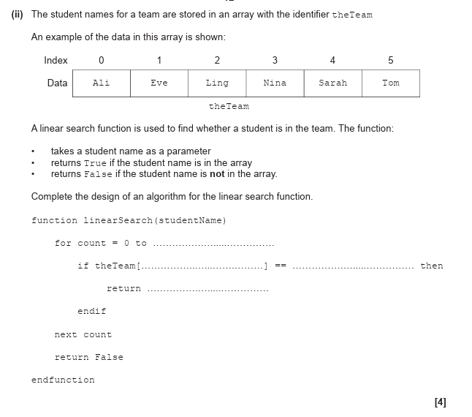
Jun 2024

Slide 7
Jun 2024
Data structure that stores similar items as a single identifier e.g
[“apple”, “Banana”,, “Orange”]

Slide 8
Jun 2024
A variable that is listed in the functions declaration

Slide 9
Jun 2024
A search algorithm used on unordered lists, examines each element from the beginning in sequence until the target element is found or when end of the list is reached

Slide 10
Jun 2024

Slide 11
Jun 2024
theTeam.length-1
count
studentName
True

Slide 12

Tracing an Algorithm

Slide 13

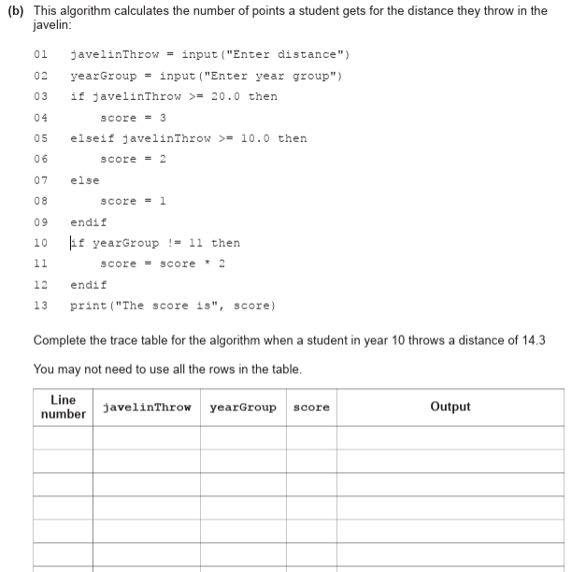
June 2024

Slide 14
June 2024
01 14.3

Slide 15
June 2024
01 14.3
02 10

Slide 16
June 2024
01 14.3
02 10
06 2

Slide 17
June 2024
01 14.3
02 10
06 2
11 4

Slide 18
June 2024
01 14.3
02 10
06 2
11 4
13 The score is 4

Slide 19

Creating solutions

Slide 20

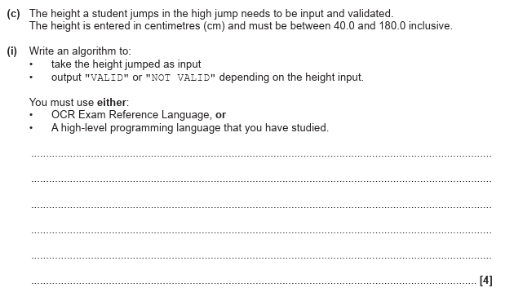
June 2024
h = input("Enter height jumped")
if h >= 40 AND h <= 180 then
print("valid")
else
print("not valid")
endif

Slide 21
June 2024
h = float(input("Enter height jumped: "))
if 40 <= h <= 180:
print("valid")
else:
print("not valid")

Slide 22

Developing solutions

Slide 23

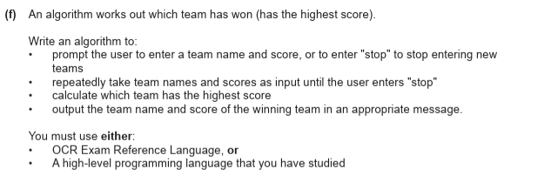
June 2024
(6)

Slide 24
highscore = 0
while team != "stop"
team = input("enter team name") score = input("enter score")
if score > highscore then
highscore = score
highteam = team
endif
endwhile
print(highscore)
print(highteam)
June 2024
(6)

Slide 25
June 2024
highscore = 0 This sets up a starting value for the highest score so far - at the start it is 0
while team != "stop" team = input("enter team name")
score = input("enter score")
if score > highscore then
highscore = score
highteam = team
endif
endwhile
print(highscore)
print(highteam)
(6)

Slide 26
June 2024
highscore = 0 This sets up a starting value for the highest score so far - at the start it is 0
while team != "stop" The loop is meant to keep running until the user types "stop" team = input("enter team name")
score = input("enter score")
if score > highscore then
highscore = score
highteam = team
endif
endwhile
print(highscore)
print(highteam)
if the current team’s score is greater than the highest one seen so far.
Update highscore to this new score. Remember the highteam (the team that currently holds the top score)
(6)

Slide 27
June 2024
highscore = 0 This sets up a starting value for the highest score so far - at the start it is 0
while team != "stop" The loop is meant to keep running until the user types "stop" team = input("enter team name")
score = input("enter score")
if score > highscore then
highscore = score
highteam = team
endif
endwhile
print(highscore)
print(highteam)
if the current team’s score is greater than the highest one seen so far.
Update highscore to this new score. Remember the highteam (the team that currently holds the top score)
The loop repeats until the user enters "stop" as the team name.
(6)

Slide 28
June 2024
highscore = 0 This sets up a starting value for the highest score so far - at the start it is 0
while team != "stop" The loop is meant to keep running until the user types "stop" team = input("enter team name")
score = input("enter score")
if score > highscore then
highscore = score
highteam = team
endif
endwhile
print(highscore)
print(highteam)
if the current team’s score is greater than the highest one seen so far.
Update highscore to this new score. Remember the highteam (the team that currently holds the top score)
The loop repeats until the user enters "stop" as the team name.
(6)
Output the the highest score
Output the name of the highest scoring team

Slide 29

SECTION HEADING

Slide 30

HEADING
Insert body text here

Slide 31

Ada, the National College for Digital Skills

