Slide 1

Ada, the National College for Digital Skills GCSE Revision - Algorithms
Reflection on robust programming, data validation, IDE and developing solutions
Ada Computer Science Team

Slide 2

Producing robust programmes

Slide 3

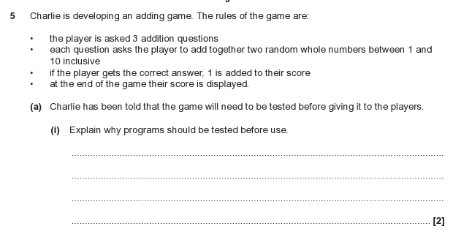
Jun 2023
String
Integer
Real/Float

Slide 4
Jun 2023
String
Check for errors/bugs
Check if program meets requirements
Check for outputs / logical errors
Test for improvements/usability
Destructive testing
Integer
Real/Float

Slide 5
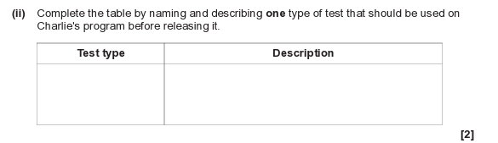
Jun 2023
Normal | Check response with data that should be accepted
Erroneous | Check to see if invalid data is rejected
Extreme | Checking response with data on edge of acceptance e.g. highest or lowest values
Iterative | Testing during development phase
Terminal | Testing at the end of development - the program as a whole

Slide 6

Maintainability

Slide 7

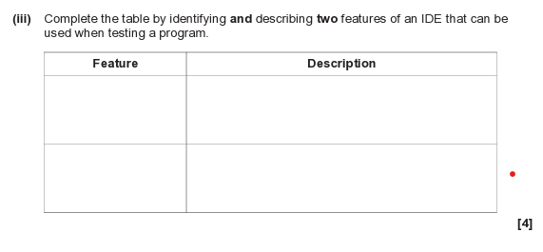
Jun 2023

Slide 8
Jun 2023
Translator/Compiler/ Interpreter | To convert high level instructions in to low level machine code so the program can be executed
Run time environment | Shows the program/code and execution
Error diagnostics | Shows type of error and location/makes suggestions on how to fix errors
Debugger | Finds errors
Break points | Stops the program at selected point
Colour coding | Distinguishes between variables, inputs, functions, outputs
Keyword completion | Suggests correct syntax when first characters are entered

Slide 9

Validation methods

Slide 10

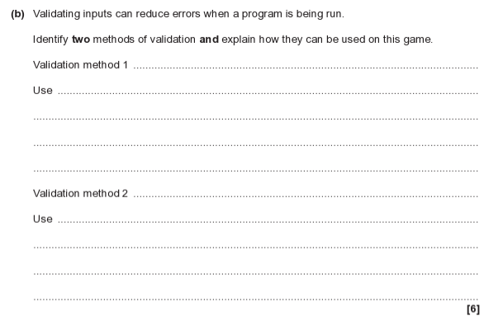
June 2023

Slide 11
June 2023
Validation technique | How it works | Linked to context
Range check | Check the data is within the upper/lower boundary | The player must enter a number between 1 and 10
Type check | Check the data is the appropriate data type | The input must be a whole number
Presence check | Ensuring data is present and the input is not blank | Entering a number as input
Length check | Limiting the number of characters entered | The number can only be 1 or 2 digits long
Format check | Ensuring the data follows the correct pattern | The input or answer is only 1 or 2 digits
Look up check | Ensuring the data is only from a select range of values | Between 1 to 10

Slide 12

Developing solutions

Slide 13

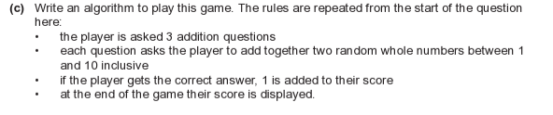
June 2023
(6)

Slide 14
June 2023
score = 0 Initialise the value of score to 0 to begin with
for count = 1 to 3
num1 = random(1, 10)
num2 = random(1, 10)
ans = input("What is” +num1 + " + " + num2 + "?")
if ans = num1 + num2 then
score = score + 1
end if
next count
print("You scored " + score)
(6)

Slide 15
June 2023
score = 0 Initialise the value of score to 0 to begin with
for count = 1 to 3 A for loop as we know 3 questions to be asked
num1 = random(1, 10)
num2 = random(1, 10)
ans = input("What is” +num1 + " + " + num2 + "?")
if ans = num1 + num2 then
score = score + 1
end if
next count
print("You scored " + score)
(6)

Slide 16
June 2023
score = 0 Initialise the value of score to 0 to begin with
for count = 1 to 3 A for loop as we know 3 questions to be asked
num1 = random(1, 10) Input value of num 1 (note random function)
num2 = random(1, 10) input value of num 2
ans = input("What is” +num1 + " + " + num2 + "?")
if ans = num1 + num2 then
score = score + 1
end if
next count
print("You scored " + score)
(6)

Slide 17
June 2023
score = 0 Initialise the value of score to 0 to begin with
for count = 1 to 3 A for loop as we know 3 questions to be asked
num1 = random(1, 10) Input value of num 1 (note random function)
num2 = random(1, 10) input value of num 2
ans = input("What is” +num1 + " + " + num2 + "?") Taking in user answer through output question - note the use of concatenation to join string values together
if ans = num1 + num2 then
score = score + 1
end if
next count
print("You scored " + score)
(6)

Slide 18
June 2023
score = 0 Initialise the value of score to 0 to begin with
for count = 1 to 3 A for loop as we know 3 questions to be asked
num1 = random(1, 10) Input value of num 1 (note random function)
num2 = random(1, 10) input value of num 2
ans = input("What is” +num1 + " + " + num2 + "?") Taking in user answer through output question - note the use of concatenation to join string values together
if ans = num1 + num2 then Checking using condition if user answer correct
score = score + 1
end if
next count
print("You scored " + score)
(6)

Slide 19
June 2023
score = 0 Initialise the value of score to 0 to begin with
for count = 1 to 3 A for loop as we know 3 questions to be asked
num1 = random(1, 10) Input value of num 1 (note random function)
num2 = random(1, 10) input value of num 2
ans = input("What is” +num1 + " + " + num2 + "?") Taking in user answer through output question - note the use of concatenation to join string values together
if ans = num1 + num2 then Checking using condition if user answer correct
score = score + 1 if correct the value of score increments by 1
end if
next count
print("You scored " + score)
(6)

Slide 20
June 2023
score = 0 Initialise the value of score to 0 to begin with
for count = 1 to 3 A for loop as we know 3 questions to be asked
num1 = random(1, 10) Input value of num 1 (note random function)
num2 = random(1, 10) input value of num 2
ans = input("What is” +num1 + " + " + num2 + "?") Taking in user answer through output question - note the use of concatenation to join string values together
if ans = num1 + num2 then Checking using condition if user answer correct
score = score + 1 if correct the value of score increments by 1
end if
next count Moves to the next question - loop ends when count = 3
print("You scored " + score)
(6)

Slide 21
June 2023
score = 0 Initialise the value of score to 0 to begin with
for count = 1 to 3 A for loop as we know 3 questions to be asked
num1 = random(1, 10) Input value of num 1 (note random function)
num2 = random(1, 10) input value of num 2
ans = input("What is” +num1 + " + " + num2 + "?") Taking in user answer through output question - note the use of concatenation to join string values together
if ans = num1 + num2 then Checking using condition if user answer correct
score = score + 1 if correct the value of score increments by 1
end if
next count Moves to the next question - loop ends when count = 3
print("You scored " + score) Final score output
(6)

Slide 22
June 2023
import random
score = 0
for count in range(1, 4): # loops from 1 to 3
num1 = random.randint(1, 10)
num2 = random.randint(1, 10)
ans = int(input(f"What is {num1} + {num2}? "))
if ans == num1 + num2:
score += 1
print(f"You scored {score}")
lets you use random number generation.
counts from 1 to 3 (since Python ranges stop before the last number).
picks a random integer between 1 and 10 (inclusive).
uses an f-string to insert the numbers into the question. converts the answer from a string to an integer. checks if the answer is correct. adds 1 point for each correct answer.
prints the final score
(6)

Slide 23

Ada, the National College for Digital Skills

