Slide 1

Ada, the National College for Digital Skills Revision for Pearson Computing
Von Neumann Architecture
6th May 2026

Slide 2

Do Now
Term | Purpose
ALU | ?
Cache | ?
Program Counter | ?
Embedded system | ?
Application: What is the difference between RAM and cache? (2 marks)
Notes:
ALU = calculations + logic
Cache = small fast memory storing frequently used data
Program Counter = stores address of next instruction
Embedded system = computer built into another device for dedicated purpose

Slide 3

Systems Architecture
The design and organisation of a computer system.
CPU structure
Memory Architecture
How instructions are processed
Notes:
The term Computer architectures refer to a set of rules stating how computer software and hardware are combined together and how they interact to make a computer functional, furthermore, the computer architecture also specifies which technologies the computer is able to handle.

Slide 4
Systems Architecture
INPUT > Memory> CPU > Output
The CPU is the Processor but it needed memory and instructions to function
Key idea:
The architecture determines how the computer processes data.

Slide 5
Back in the day…
Early computers often had to be physically rewired or manually re-configured to run a different program.
Imagine an old-fashioned microwave where the cooking instructions are built into the machine itself.
If it was designed to cook pizza - it only knows pizza instructions
If you want to heat soup?
You have to open it up and physically change the wiring/buttons inside.
That’s how many early computers worked.
The “program” wasn’t stored in memory — it was part of the machine setup.

Slide 6
Back in the day…
Not flexible
Microwave only cooks one thing.
Want popcorn? Can’t.
Need a redesign.
Computer equivalent: One machine, one task.
Slow to change tasks
To switch from pizza mode to soup mode, you physically rebuild settings.
Computer equivalent: Rewiring switches/ cables.
Very slow.
More mistakes
Every time you rewire the microwave, you might make a mistake.
Computer equivalent: Human configuration errors.
Not practical
Imagine changing microwave wiring every time you wanted a different meal.
That would be ridiculous.
Same problem with computers.

Slide 7

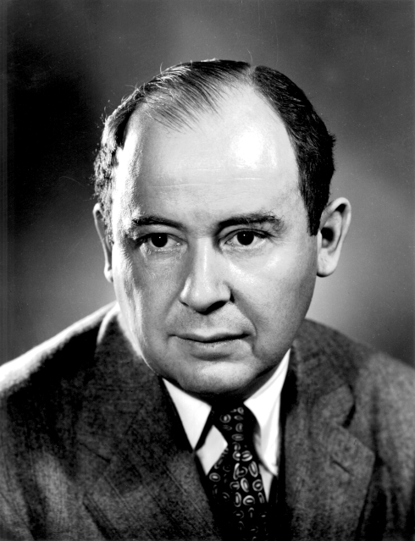
The Von Neumann Architecture
Old computer: “Rebuild the microwave every meal.”
Von Neumann computer: “Use the same microwave, choose a different setting.”

Slide 8
Modern computing
The instructions for a program are stored in main memory alongside the data the program uses.
The microwave is the hardware (the physical machine).
The food is the data.
The cooking instructions are the program instructions.
Pizza → 2 minutes Soup → 3 minutes Popcorn → popcorn setting
The microwave doesn’t change physically. Only the instructions change.
That’s the stored-program concept.
Example, you put in:
pizza
soup
popcorn
Same microwave - but each needs different instructions.

Slide 9
Modern computing
How the stored-program concept fixed it
Modern microwave, Same machine.
Instructions are selected and followed.
No rebuilding.
Modern computer:
Same hardware.
Just load:
Microsoft Word
Google Chrome
Minecraft
Different stored instructions.

Slide 10

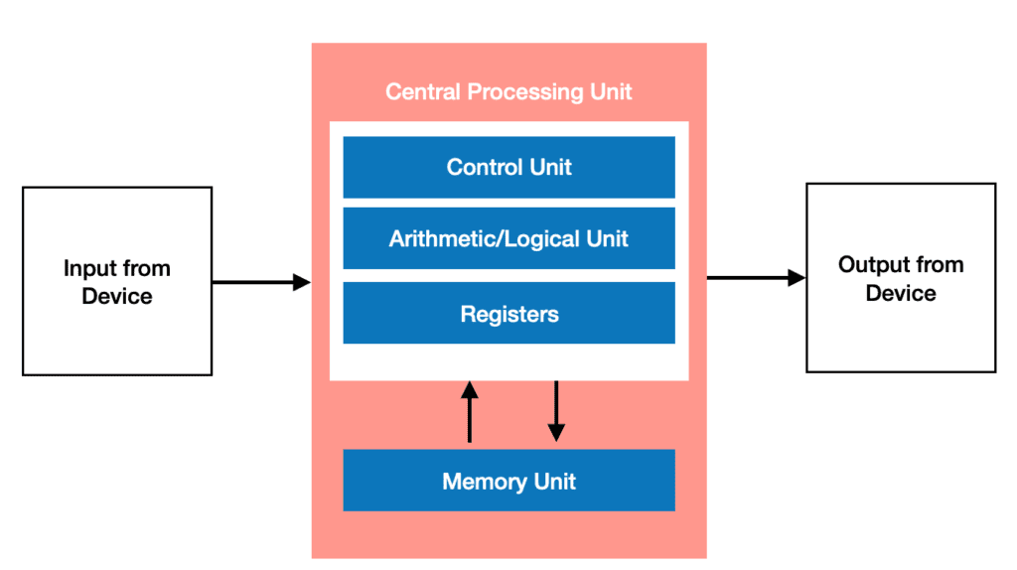
What is it?
Instructions and data are stored in the same memory.
Notes:
The CPU is an electronic circuit, which executes instructions of the computer program.
The CPU can also be referred to as a microprocessor or a processor.

Slide 11
What is it?
Instructions and data are stored in the same memory.
Calculations
Logic comparisons
Notes:
Controls the operation of the ALU, memory, and input/output, instructing them how to respond to the instructions from the program it had just read and interpreted from the memory unit. The control unit directs the operations of the CPU by executing the following jobs:
Coordinating and controlling activities of the CPU
Managing data flow between other components and the CPU
Acknowledging and accepting the next instruction
Decoding instructions
Storing the resulting data back into a memory unit

Slide 12
What is it?
Instructions and data are stored in the same memory.
Controls execution
Decodes instructions
Calculations
Logic comparisons
Notes:
Allows logical and arithmetic operations to be carried out such as addition and subtraction.
(Logical operators are: AND, OR, NOT, XOR)

Slide 13
What is it?
Instructions and data are stored in the same memory.
Controls execution
Decodes instructions
Calculations
Logic comparisons
Special fast storage:
Program counter (Next instruction address
MAR (Memory Address)
MDR (Data being transferred)
CIR (Current instruction
Notes:
Small block in the CPU that consists of a high-speed storage memory cells that store data before it is processed, all logical, arithmetic, and shift operations occur here.
The register consist of 5 components
Program Counter (PC): Holds the address of the next instruction to be executed
Accumulator (AC): Storage area where logic and arithmetic results are stored
Memory Address Register (MAR): Holds the address of a location of the data that is to be read from or written to
Memory Data Register (MDR): Temporary storage location that stores data that has been read, or data that still needs to be written
Current Instruction Register (CIR): Area where the current instruction is being carried out. The operation is divided into operand and opcode.
Operand: Contains data or the address of the data (where the operation will be performed)
Opcode: Specifies type of instruction to be executed

Slide 14
What is it?
Instructions and data are stored in the same memory.
The stored Program Concept
Notes:
von Neumann Architecture is based on the fact that the program data and the instruction data are stored in the same memory unit. This can also be referred to as the “stored program concept”.
This design is still used in the computer produced nowadays:

Slide 15
Quick check
What is stored in Memory in the Von Neumann Architecture?
What are registers?
What is meant by systems architecture?

Slide 16

Buses

Slide 17

What are they?
A pathway that transfers data between components
Data Bus
Carries data/instructions
Bi-directional
memory ↔ CPU

Slide 18
What are they?
A pathway that transfers data between components
Address Bus
Carries memory addresses
One directional
CPU → memory

Slide 19
What are they?
A pathway that transfers data between components
Control Bus
Carries control signals
Bi-directional
Read/write signals

Slide 20
Buses recall
Address = Where?
Data = What?
Control = How?

Slide 21

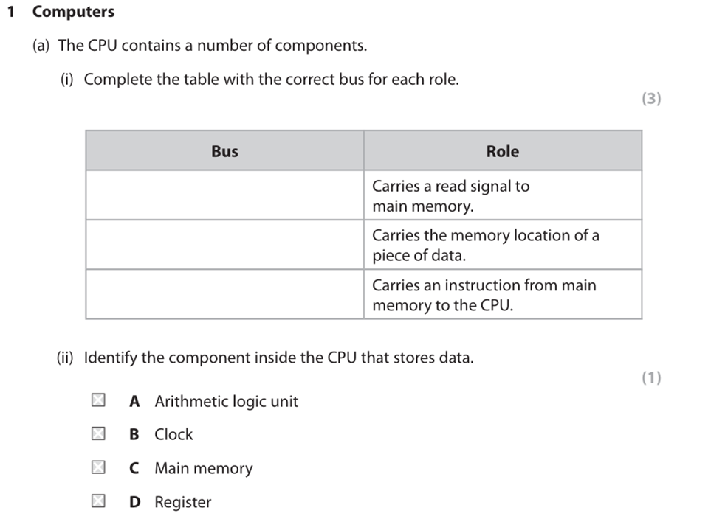
Exam Q

Slide 22
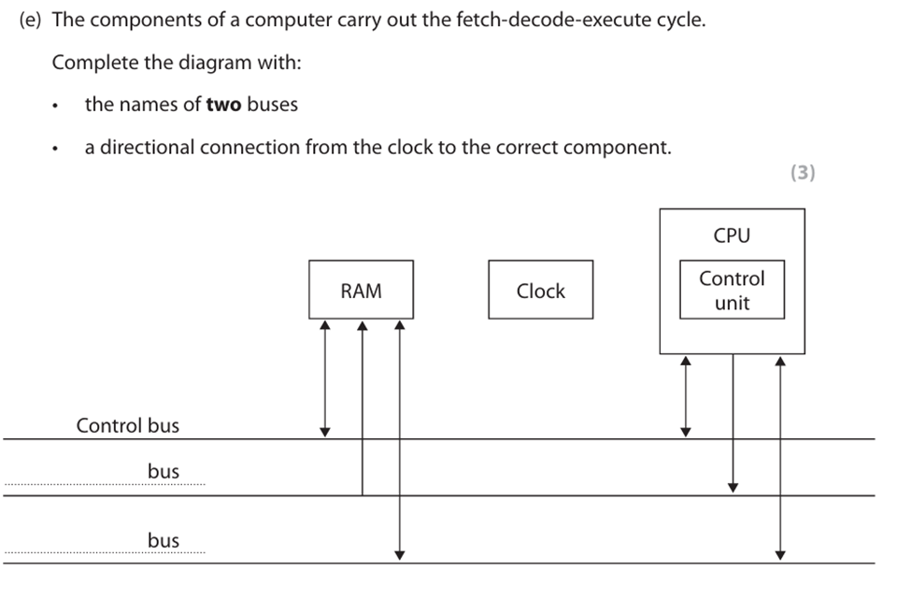
Exam Q

Slide 23
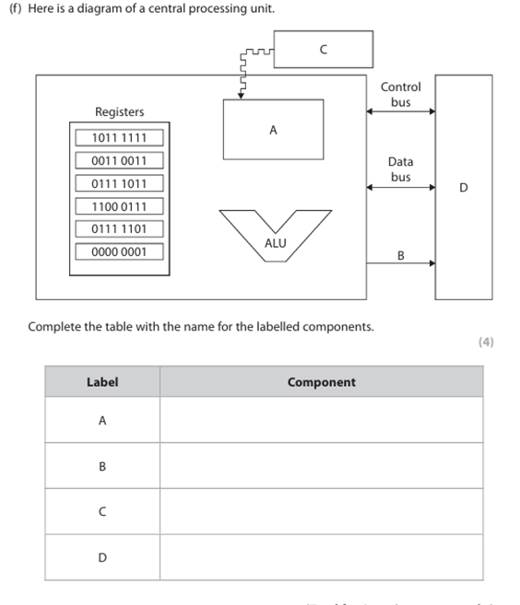
Exam Q

Slide 24

Fetch- Decode-Execute Cycle

Slide 25

Fetch
PC stores next instruction address
Address copied to MAR
Address sent along address bus
Data returns along data bus into MDR
Instruction copied into CIR
PC increments

Slide 26
Decode
CU decodes

Slide 27
Execute
Instruction carried out
Important link: Buses make the cycle possible.
Which bus carries the address to memory?

Slide 28
Systems Architecture
Annotate this
Term | Purpose
ALU | ?
Cache | ?
Program Counter | ?
Embedded system | ?
What is meant by systems Architecture?
Bus | Characteristic | Purpose
Data
Control
Address
Quick Check
What is stored in Memory in the Von Neumann Architecture?
What are registers?
What is meant by systems architecture?

Slide 29
Exam Qs

Slide 31





Any questions?

Slide 32
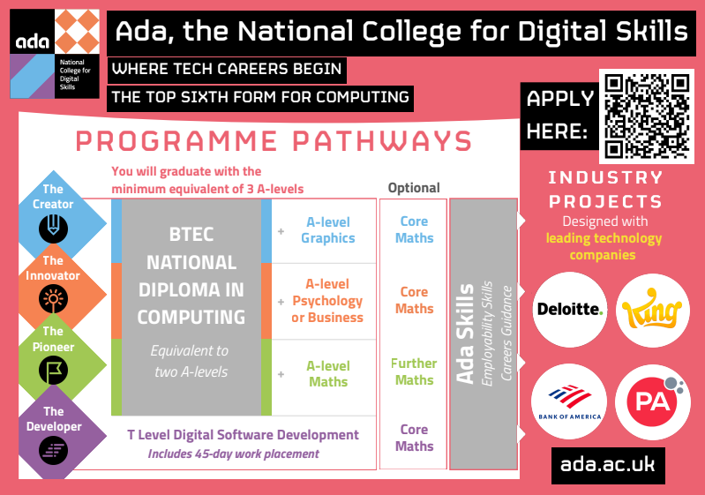

Slide 33

Ada, the National College for Digital Skills

