Slide 1

Ada, the National College for Digital Skills Revision for Pearson Computing
TCP/IP
6th May 2026

Slide 2

Quick recall
What does IP stand for?
What is a packet?
Why is data split into packets?
What does TCP stand for?
Application: What is the difference between RAM and cache? (2 marks)
Notes:
ALU = calculations + logic
Cache = small fast memory storing frequently used data
Program Counter = stores address of next instruction
Embedded system = computer built into another device for dedicated purpose

Slide 3
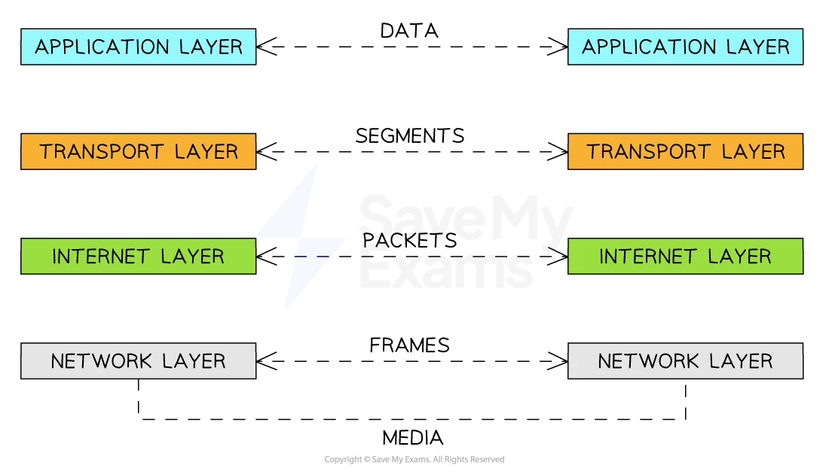
TCP/IP and Packet Switching - Revision with Ada
Quick recall
What does IP stand for?
What is a packet?
Why is data split into packets?
What does TCP stand for?
Splits data into packets
Exam Q’s
HEADER
State the role of IP.
Explain why TCP is important
Explain how TCP/IP sends a file across the internet.
PAYLOAD
IP - what is it?
FOOTER
2. Assembling
Quick recall:
Job
Job
Which protocol handles addressing?
Which protocol ensures reliability?
What is packet switching?
Why might packets arrive in the wrong order?
Which protocol reorders them?

Slide 4

TCP/IP - what is it?
A protocol suite used for communication over networks
Think of it like teamwork:
IP = handles addressing and routing
TCP = ensures reliable delivery
Together, they allow devices to communicate
Notes:
The term Computer architectures refer to a set of rules stating how computer software and hardware are combined together and how they interact to make a computer functional, furthermore, the computer architecture also specifies which technologies the computer is able to handle.

Slide 5
IP - Two main jobs
Addressing - Every device has an IP address - this identifies the sender and receiver
E.g 192.168.1.5
Routing - IP jelps packets travel across networks to the correct destination (Tip IP = Identify Path)

Slide 6
TCP - How it works
With a focus on reliability TCP:
Splits data into packets
Header - Source, destination, packet number
Payload - the actual data being sent
Footer - Error checking info - requests packet again
Reassembles packets in order
Memory tip: TCP = Check, Control, Put together

Slide 7
TCP - quick tip
Header = Where? (source, destination, packet number)
Payload = What? (the actual data)
Footer = Correct? (error checking)

Slide 9

How is data sent?

Slide 10

Packet switching

Slide 11

What is it?
Data is split into smaller parts and sent separately
Why is this good?
Efficient
Can reroute if network busy
Reliable
Why might this be bad?
Packets arrive out of order BUT TCP fixes this

Slide 12
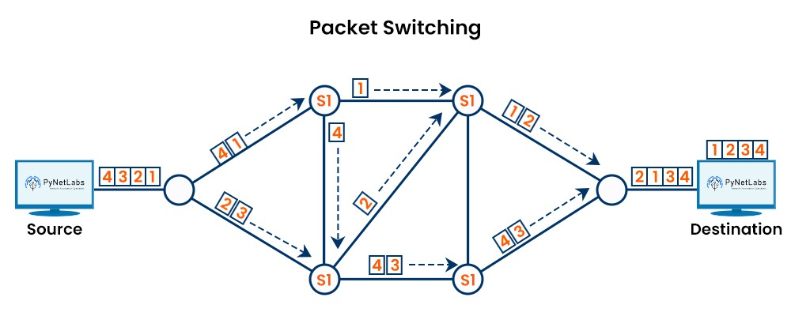
What is it?

Slide 13
Imagine sending a photo
Step 1: TCP breaks the file into packets.
Each packet contains
Data
Sequence number
Destination IP
Source IP
Error-checking info

Slide 14
Imagine sending a photo
Step 1: TCP breaks the file into packets.
Each packet contains
Data
Sequence number
Destination IP
Source IP
Error-checking info
Step 2: IP sends packets across the network
Packets may take take different routes

Slide 15
Imagine sending a photo
Step 1: TCP breaks the file into packets.
Each packet contains
Data
Sequence number
Destination IP
Source IP
Error-checking info
Step 2: IP sends packets across the network
Packets may take take different routes
Step 3: the receiving device gets packets

Slide 16
Imagine sending a photo
Step 1: TCP breaks the file into packets.
Each packet contains
Data
Sequence number
Destination IP
Source IP
Error-checking info
Step 2: IP sends packets across the network
Packets may take take different routes
Step 3: the receiving device gets packets
Step 4: TCP Checks:
Are all packets there?
Are they in order?
Are any damaged?

Slide 17
Imagine sending a photo
Step 1: TCP breaks the file into packets.
Each packet contains
Data
Sequence number
Destination IP
Source IP
Error-checking info
Step 2: IP sends packets across the network
Packets may take take different routes
Step 3: the receiving device gets packets
Step 4: TCP Checks:
Are all packets there?
Are they in order?
Are any damaged?
Step 5: TCP rebuilds the original file

Slide 18

Exam Q
Question 1 (2 marks)
State the role of IP.

Slide 19
Exam Q
Question 1 (2 marks)
IP provides addressing and routes packets to the correct destination.

Slide 20
Exam Q
Question 2 (3 marks)
Explain why TCP is important.

Slide 21
Exam Q
Question 2 (2 marks)
TCP ensures data is delivered reliably by splitting data into packets, checking for errors, and reordering packets correctly.

Slide 22
Exam Q
Question 3 (4 marks)
Explain how TCP/IP sends a file across the internet.

Slide 23
Exam Q
Question 3 (4 marks)
TCP splits the file into packets and numbers them. IP adds addressing information and routes the packets across the network. The packets may travel different routes. TCP checks and reassembles them in the correct order.

Slide 24

Quick check in

Slide 25

Recall
Answer without notes:
Which protocol handles addressing?
Which protocol ensures reliability?
What is packet switching?
Why might packets arrive in the wrong order?
Which protocol reorders them?

Slide 26
Recall
Answers:
IP
TCP
Sending data in chunks/packets
Different routes
TCP

Slide 27




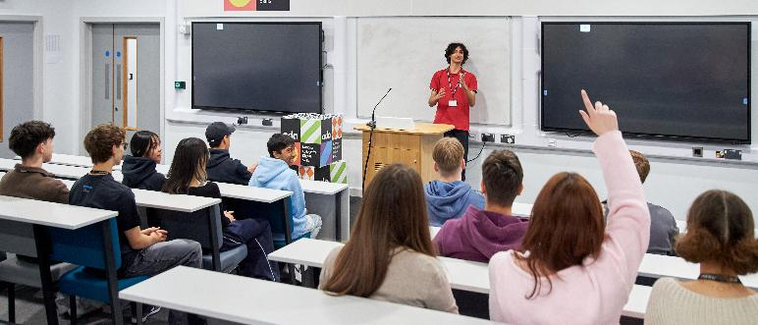
Any questions?

Slide 28


Slide 29

Ada, the National College for Digital Skills

