Slide 1

Ada, the National College for Digital Skills Revision for Paper 2 - algorithms
23rd April 2024

Slide 2

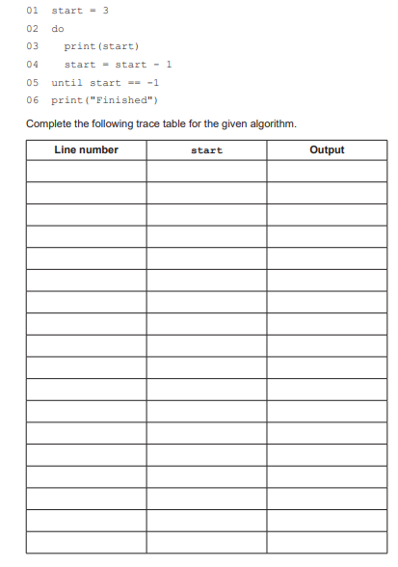
Do Now
Create a step-by-step log of what the program is 'thinking' (the variable values) and what it 'says' (the output) every time it runs a line of code
The "Start" Variable: is just a storage box. Whenever you see start = start - 1, the value for that variable i.e. the number inside that box is subtracting one
do-until is a "do-it-anyway" loop. It doesn't check the rules (the condition) until after it has already done the work
Column 1 (Line Number): This is where you are in the "instruction manual" (the code).
Column 2 (start Value): This is the current number sitting in the computer's memory.
Column 3 (Output): This is the message the user sees on the screen.

Slide 3

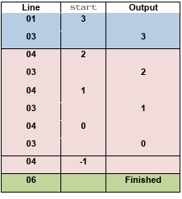
Explanation
Step-by-Step Logic Breakdown
Initialization (Line 01): We set start = 3.
First Loop Iteration:
Line 03: Prints the current value of start (3).
Line 04: Decrements start to 2.
Line 05: Checks if start == -1. It is 2, so the loop continues.
Subsequent Iterations: The loop repeats these steps, printing 2, 1, and 0.
The Exit Condition:
After printing 0 (Line 03) and decrementing (Line 04), start becomes -1.
The loop reaches the condition check at Line 05 (until start == -1). Since this is now True, the loop terminates.
Completion: The program moves to Line 06, printing "Finished".

Slide 4

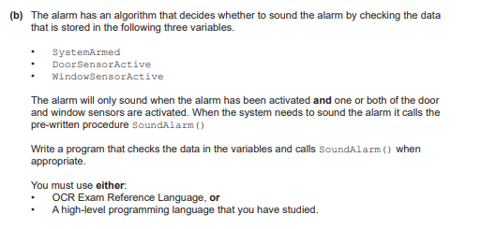

Slide 5

Breaking it down…
What the question is saying
You have 3 variables:
SystemArmed → is the alarm turned on?
DoorSensorActive → is the door sensor triggered?
WindowSensorActive → is the window sensor triggered?
The alarm should sound ONLY IF:
The system is armed SystemArmed == TRUE
AND
At least one sensor is active 👉 DoorSensorActive == TRUE OR WindowSensorActive == TRUE
Step-by-step logic
Step 1: Check if system is armed
If it’s not armed → do nothing.
Step 2: If armed, check sensors
If door OR window is active → sound alarm
Otherwise → do nothing

Slide 6
The solution
What the question is saying
IF SystemArmed = TRUE THEN
IF DoorSensorActive = TRUE OR WindowSensorActive = TRUE THEN
CALL SoundAlarm()
ENDIF
ENDIF
✔
✔
✔
✔

Slide 7

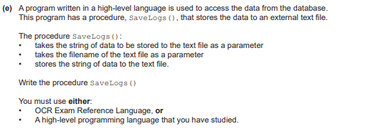

Slide 8

When you need to save data f to a text file, you are essentially performing a "Write" operation.
1. Defining the Procedure
A procedure is a sub-routine that performs a task but does not necessarily return a value.
Parameters: These act as placeholders. By defining (dataString, filename) in the procedure header, you make the code reusable. You can call SaveLogs() at any point in your program for any data and any file without rewriting the logic.
2. The Three-Step File Operation
Regardless of the language, file interaction almost always follows these three fundamental steps to ensure data integrity:
Opening: You must open the file to create a "bridge" between your RAM and the hard drive.
Writing: This is the actual transfer of data from your program's variable to the external file storage.
Closing: This is the most important step. When you "write" to a file, the data is often held in a temporary memory buffer. Calling the close command flushes that buffer to the disk and releases the file so that other programs (or other parts of your own program) can access it without causing corruption or "file locked" errors.
Breaking it down…

Slide 9
The solution
#Name of the procedure
✔
✔
PROCEDURE SaveLogs(dataString, filename)
logFile = open(filename)
logFile.writeLine(data)
logFile.close()
endprocedure
✔
#takes the data as string with filename
✔
#opening the named file
✔
#transferring data values from the variable to the text file
✔
#Closing the file and removing from temp storage

Slide 10

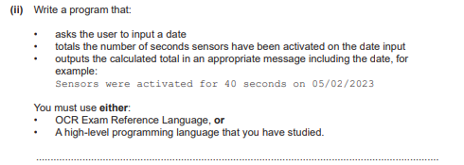

Slide 11

Breaking it down…
To solve this problem, we need to design a program that interacts with a data source and sum up some information.
Since you are totalling sensor durations for a specific date, you need to iterate through the stored data, compare the date of each entry to the user's input, and accumulate the seconds.
The Logic Breakdown
Input: Ask the user for the target date.
Initialize: Create a variable (e.g., total) set to 0 to act as your running total.
Process (Iteration):
Open the file containing the log data.
Read the file line-by-line.
Check if the line contains the date input by the user.
If it does, extract the number of seconds from that line and add it to totalSeconds.
Output: Display the result using the requested format.

Slide 12
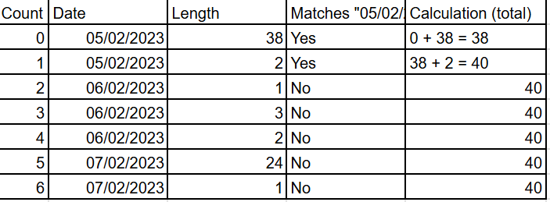
Let’s visualise it
Initialize: total = 0.
User Input: User enters date = "05/02/2023".
Looping:
count = 0: Date matches! total becomes 0 + 38= 38.
count = 1: Date matches! total becomes 38+ 2= 40.
count = 2: Date is "06/02/2023" (No match). total remains 40.
count = 3: Date matches! total becomes 25 + 15 = 40
…
…
…
Final Output
Once the loop finishes checking all indices, the program prints the result:
"There were 40 events on 05/02/2023"

Slide 13
The solution
#This is your accumulator. You are preparing a container to hold the sum of seconds. Starting it at zero ensures that you have a clean slate before you start adding up the sensor data.
total = 0
date = input("Please enter date")
for count = 0 to events.length-1
if events[0, count] == date then
total = total + duration[3,count]
endif
next count
print("There were " + total + " events on " + date)
✔
✔
# The user will specify which day they are interested in. This variable becomes the "key" to check
#This loop ensures the program checks every single record in the array.
events[0, count]: This part of your code acts as the data selector. It looks at the first column (index 0) of the current row which is where the date is stored.
✔
✔
#here the program compares the date in the array in the current position to the user's input.
If they match, it proceeds to the next line to update the total
If they do not match, it ignores that record and moves to the next
✔
✔

Slide 14

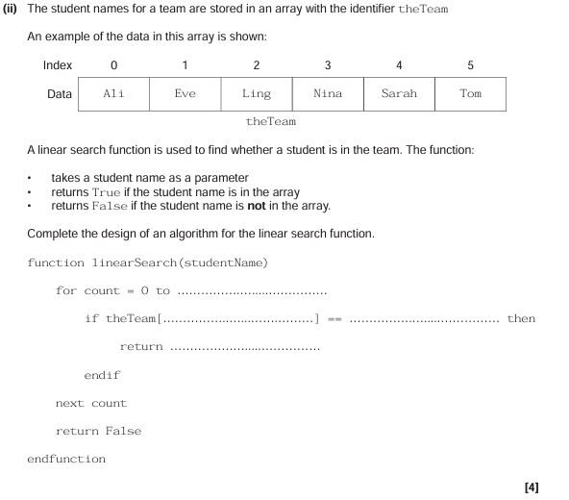
theTeam.length() - 1
Count
StudentName
True

Slide 15

Breaking it down
Linear search - starts at first elements, iterates through array until target found or until end of the array
Make sure you know the difference between Linear and Binary
Binary = faster for large data sets - precondition means it must be in order!
Work out Mid point
Compare target with mid point is found then stop search. If not found then
If Midpoint>than target value discard this and items to right side
If Midpoint<than target value discard this and items to left side
Repeat until midpoint = target
Linear = small unordered data sets

Slide 16

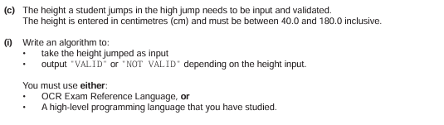

Slide 17

Breaking it down…
Input: Ask the user for the value (height).
Validation: Check if the value meets both conditions simultaneously:
It must be greater than or equal to 40.0.
It must be less than or equal to 180.0.
Conditional Output:
If both conditions are true, output "VALID".
If either condition is false (the value is too low or too high), output "NOT VALID".

Slide 18
The solution
h = input("Enter height jumped")
if h >= 40 and h <= 180 then
print("valid")
else
print("not valid")
endif
✔
✔
✔
✔

Slide 19
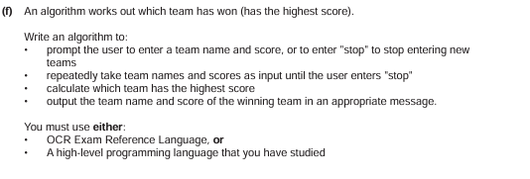

Slide 20
The break down
Initialize Variables: You need two variables
To keep track of the leader: highestScore (set to -1)
winnerName (set to an empty string as we don’t know who it is yet).
The Loop: Use a WHILE loop that runs until the user types "stop" - this is because it based on a condition and the iterations are not known.
Comparison: Inside the loop, every time a new score is entered, compare it to the current highestScore.
If the new score is greater than the highestScore, update highestScore to the new value and winnerName to the new name.
Output: Once the user types "stop", print the variables holding the winner's information.

Slide 21
The solution
highscore = 0: This is your accumulator variable. By starting at 0, you ensure that even the first valid score entered (assuming it is greater than 0) will beat the current "record."
highscore = 0
while team != "stop"
team = input("enter team name")
score = input("enter score")
if score > highscore then
highscore = score
highteam = team
endif
endwhile
print(highscore)
print(highteam)
Comparison: The if score > highscore statement acts as a filter.
If the new score is higher than the current record, it "overwrites" the old record.
If the new score is lower, it does nothing and proceeds to the next iteration.
Updating: highscore = score and highteam = team are the critical steps. This is where the program "remembers" the best result found so far

Slide 22

Ada, the National College for Digital Skills

